Slide 1

COMP 499/691: Conversational Artificial Intelligence
Introduction to Deep Learning
Computer Science & Software Engineering
Concordia University, Winter 2024

Slide 2
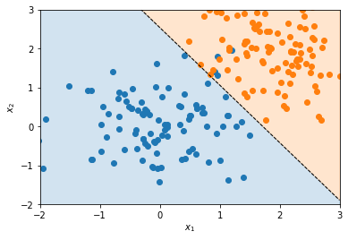
Outline
Basic Machine Learning Concepts
Linear Models
Neural Networks

Slide 3

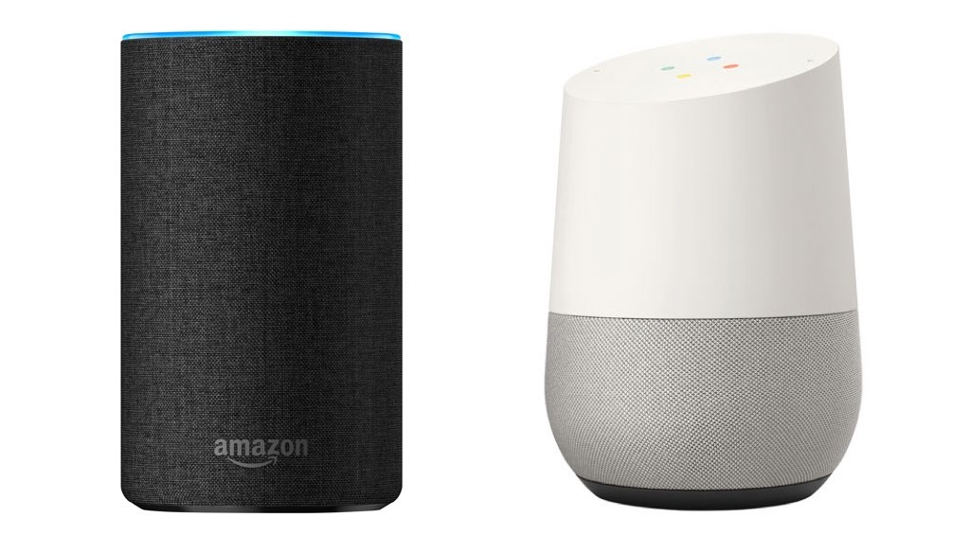
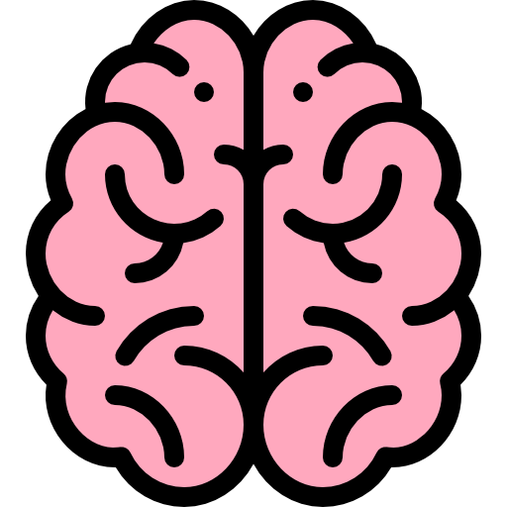

Introduction
Last lecture, we have seen that Conversational AI systems are composed of several technologies.
Acoustic Environment
Recording Setup
Voice Activity Detection
Speech
Enhancement
Keyword Spotting
Machine Learning and Deep Learning are used in all modules!
Speech Recognition
Acoustic Environment
Generation Setup
Speech Synthesis
Dialogue
Spoken Language Understanding
This lecture will refresh basic machine learning and deep learning concepts.

Slide 4
Basic Machine Learning

Slide 5
Machine Learning
Artificial Intelligence aims to build machines that mimic human intelligence.
Machine learning aims to reach this goal with machines that learns from data.
Artificial Intelligence
Input
output
Machine Learning
f(x) is learned from data.
Machine Learning
x
f(x)
We want a function f(x) that maps the input x into the desired output y:
In practice, we show to machine many input-output examples. The algorithm should learn the mapping between the input and output spaces with these examples.
‹#›

Slide 6
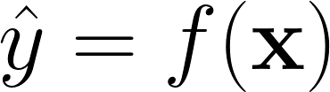
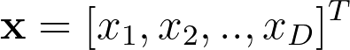
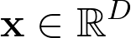
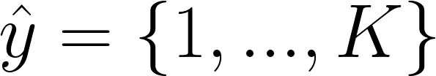
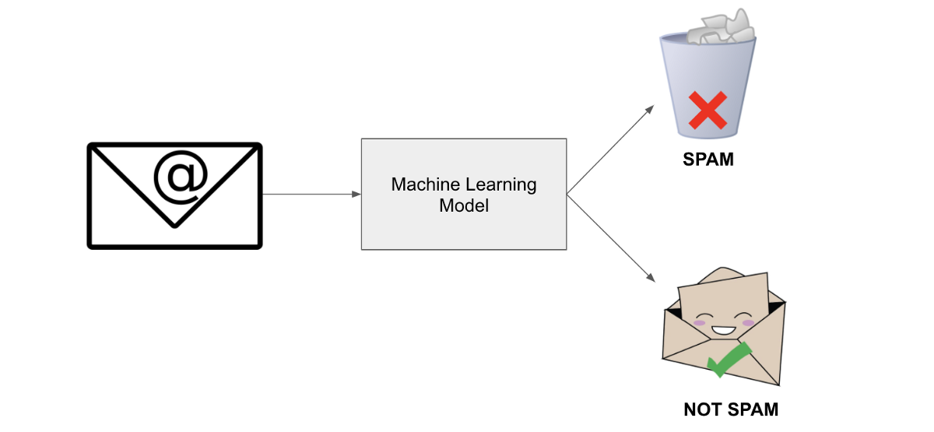
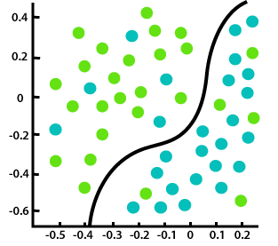

Types of Problems
Classification: the machine learning algorithm has to specify to which of the k categories some input belongs to.
Row-vector
(by convention)
Decision boundaries
f(x)
x2
1
“A”
Machine Learning
2
“B”
….
x
24
“Z”
f(x)
x1

Slide 7
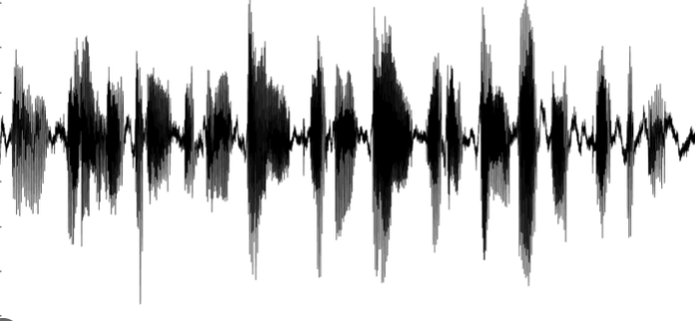
Types of Problems
Which modules require solving a classification problem?
VAD
Acoustic Environment
Recording Setup
Voice Activity Detection
Speech
Enhancement
Keyword Spotting
Speech
vs
Non Speech
Speech Recognition
Acoustic Environment
Generation Setup
Speech Synthesis
Dialogue
Spoken Language Understanding
Keyword Spotting
Speech Recognition, Spoken Language Understanding, and Dialogue are special classification problems called Sequence-to-sequence Classification.
Speech
vs
Non Speech

Slide 8
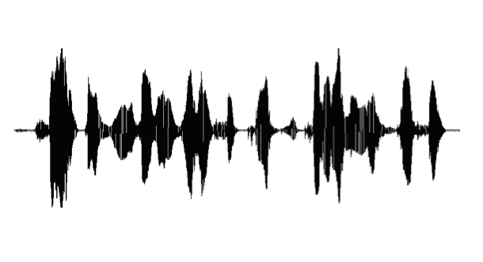
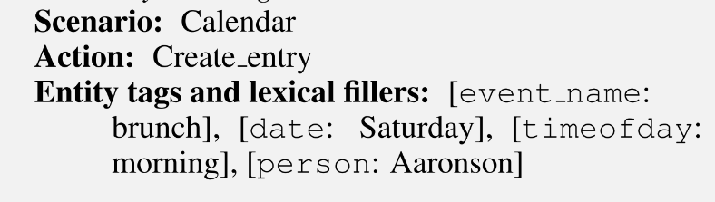
Types of Problems
Sequence-to-sequence Classification: the machine learning algorithm converts an input sequence into another one.
Machine Translation
Speech Recognition
[“Je”, “ne”, “sais”, “pas”]
Machine Translation
[“I”, “don’t”, “know”]
ASR
[“Hi”, “Everyone”]
French
English
f(x)
f(x)
Spoken Language Understanding
Dialogue
“Make a Calendar Entry for Brunch on Saturday Morning with Aaronson.”
SLU
Hi, I want to reserve a restaurant today.
Dialogue System
Which kind of food do you want to eat?
f(x)
f(x)

Slide 9
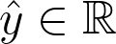
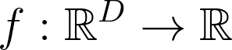
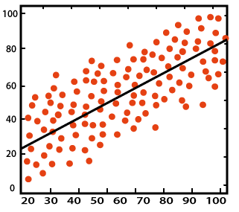
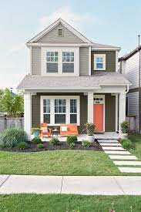
Types of Problems
Regression: the machine learning algorithm predicts a continuous value given some input.
f(x)
Row-vector
(by convention)
x2
Number of floors: 2
Machine Learning
Price
Number of bedrooms: 3
665k$
x
Age: 15
f(x)
x1

Slide 10
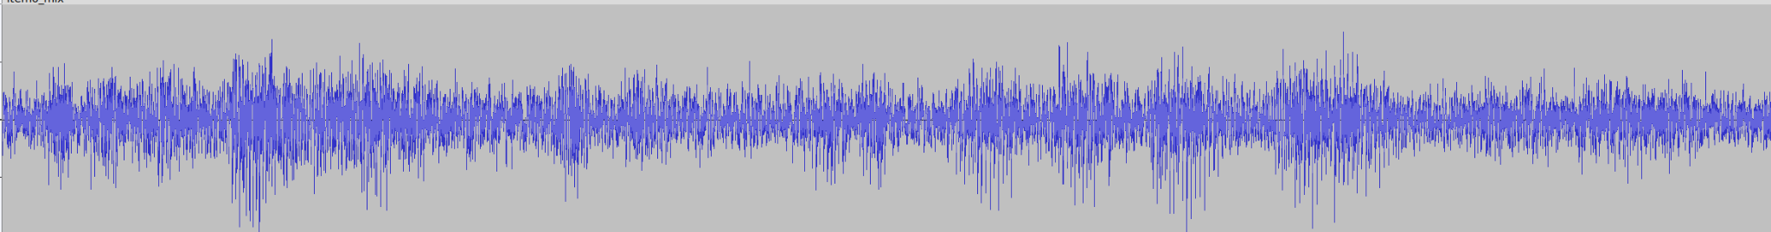
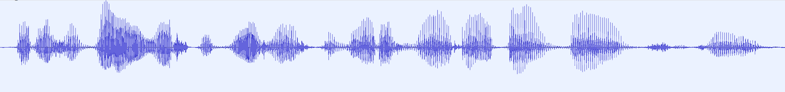
Types of Problems
Which modules require solving a regression problem?
Speech Enhancement
Acoustic Environment
Recording Setup
Voice Activity Detection
Speech
Enhancement
Keyword Spotting
Speech Recognition
“Which kind of food do you want to eat?”
Acoustic Environment
Generation Setup
Speech Synthesis
Dialogue
Spoken Language Understanding
Speech Synthesis

Slide 11
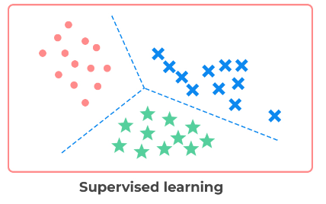
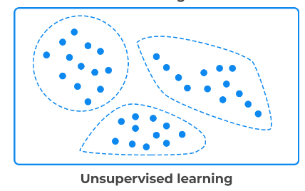
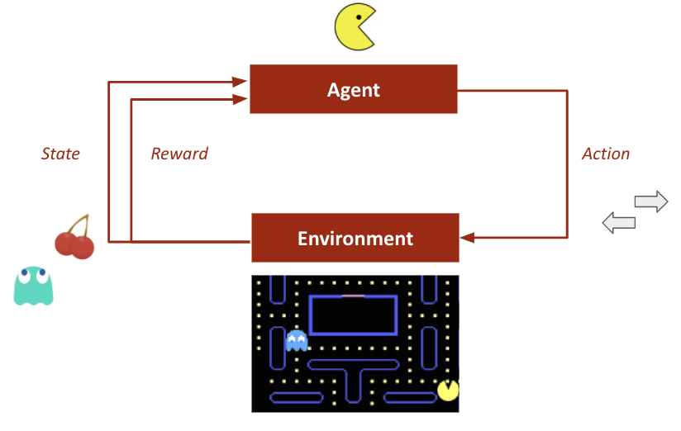
Types of Learning
Supervised
Learning from labeled examples.
Learning types
Unsupervised
Learning from observations.
Reinforced
Learning from interactions.
Supervised Learning
Unsupervised Learning
Reinforcement Learning
Labels required
No labels required
Rewards required

Slide 12
Types of Learning
Which modules require supervised learning?
Acoustic Environment
Recording Setup
Voice Activity Detection
Speech
Enhancement
Keyword Spotting
Speech Recognition
Acoustic Environment
Generation Setup
Speech Synthesis
Dialogue
Spoken Language Understanding
All modules require supervised learning.
Some modules take benefits of both unsupervised and supervised learning (e.g., the speech recognizer).

Slide 13
Basic Machine Learning
Main Components

Slide 14
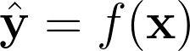
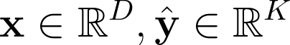
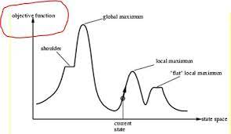

Basic Components
Input
output
Machine Learning
x
f(x)
The basic components of a machine learning system are:
Datasets: examples of input-output mappings.
Dataset
Machine learning model: implements the function f(x) that maps the inputs into the desired outputs.
Objective function: a measure of “how well” the solution f(x) fits the data.
Optimization algorithm: an algorithm that finds the function f(x) among different candidates.
In the following, we will refer to supervised machine learning.

Slide 15
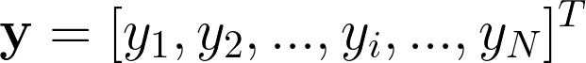
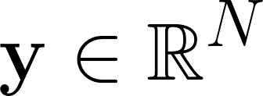
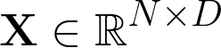
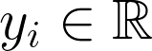
Datasets
Input
output
Machine Learning
A dataset is a collection of examples (sometimes called data points or samples) containing the desired input-output mappings.
x
f(x)
Inputs
Targets:
Number of features
x11, x12, x13, ………………………….x1D
x21, x22, x23, ………………………….x2D
x31, x32, x33, ………………………….x3D
…………………………………………………………………..
xN1, xN2, xN3, ………………………….xND
[x1, y1]
[x2, y2]
Number of Samples
……..
Target Vector
[xn, yn]
……..
[xN, yN]
Feature Matrix
Dataset

Slide 16

Datasets
In machine learning, we use training, validation, and test datasets:
Training
Dataset
Training Dataset: used to find the desired mapping function f(x).
Validation
Dataset
Validation Dataset: used to assess the performance during training (and tune the hyperparameters of the model).
Test
Dataset
Test Dataset: used to assess the performance after training.
The datasets must contain different examples.
If the test samples are already seen during training, we overestimate the performance of the system.

Slide 17
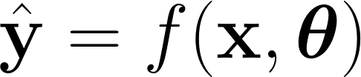
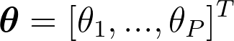
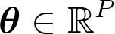
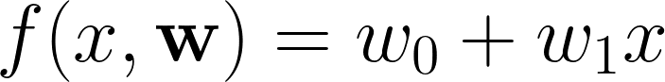
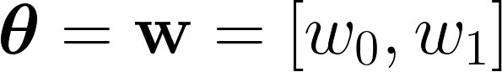
Machine Learning Model
The function implemented by a machine learning model often depends on some parameters θ
Input
output
Machine Learning
x
f(x, θ)
For instance, let’s consider the following linear model:
f1
y
W0 is the intercept and affects the shift of the line.
f2
Which are the parameters?
f3
W1 is the angular coefficient and affects the slope.
T
x

Slide 18
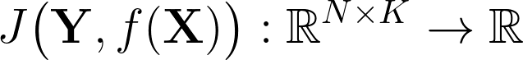
Objective
Input
output
Machine Learning
x
f(x)
During training we want to find a function f that “fits well” with my training data.
To quantify “how good” are the predictions obtained with the learning function we need to define an objective function:
This function is also called criterion.
By convention, we often want to minimize it.

Slide 19
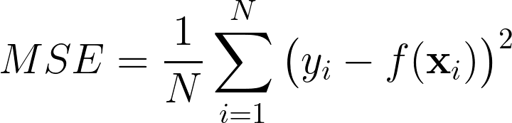
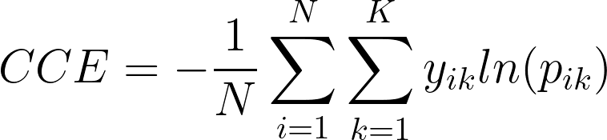
Objective
Input
output
Machine Learning
x
f(x)
Which object can we use for regression?
Examples
Classes
Natural Log
Which object can we use for classification?
Also known as
Negative Log-Likelihood (NLL)

Slide 20

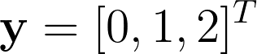
Objective
Natural Log
Why not using the classification error rate (or accuracy) directly?
Also known as
Negative Log-Likelihood (NLL)
# Classes K
# Classes K
Labels
cat
dog
1 0 0
0 1 0
0 0 1
bird
# Examples N
One-hot label representation
What are the lower and upper bounds?
Cross Entropy = -⅓ *(
1 * ln(0.6) + 0 * ln(0.2) + 0 * ln(0.2) +
0 * ln(0.3) + 1 * ln(0.5) + 0 * ln(0.2) +
0 * ln(0.1) + 0 * ln(0.5) + 1 * ln(0.4)
)
= 0.70
0.6 0.2 0.2
0.3 0.5 0.2
0.1 0.5 0.4
p(x1)
Lower Bound (perfect solution): 0
Example
p(X) =
p(x2)
Upper Bound (worst solution): +inf
p(x3)

Slide 21
Objective
Labels
In this example, the two models have the same accuracy, but different cross-entropy.
cat
dog
1 0 0
0 1 0
0 0 1
bird
One-hot label representation
Which system is better?
0.6 0.2 0.2
0.3 0.5 0.2
0.1 0.5 0.4
p(x1)
Cross Entropy = 0.70
Example 2 is better than Example 1 because the classifier is more confident about its predictions.
Example 1
p(X) =
p(x2)
Accuracy = 0.66
p(x3)
The categorical cross-entropy is a much “softer” metric that better ranks our candidate solutions.
0.9 0.1 0.0
0.0 1.0 0.0
0.1 0.5 0.4
p(x1)
Example 2
p(X) =
p(x2)
Cross Entropy = 0.34
p(x3)
Accuracy = 0.66

Slide 22
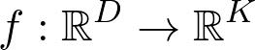
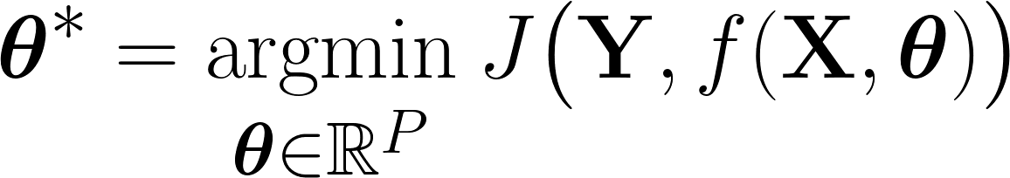
Optimization
Input
output
Machine Learning
x
f(x, θ)
During training we want to find the parameter configuration that minimizes the objective function:
θ2
f1
J(f1(X),Y)
f4
f2
J(f2(X),Y)
f3
J(f3(X),Y)
The algorithm that finds this function by exploring the parameter space is called the optimizer.
Parameter space
θ1

Slide 23
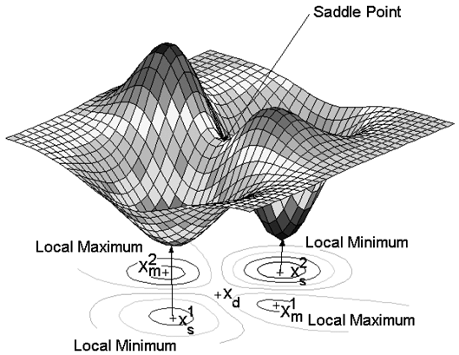
Optimization
This is usually a difficult problem:
The function usually has a lot of local minima, maxima, and saddle points.
In a real machine learning problem, we might have tons of parameters to optimize.
For instance, in modern deep learning, we might even have billions of parameters.
maximum
Plateau
maximum
Plateau
Plateau
minimum
minimum

Slide 24
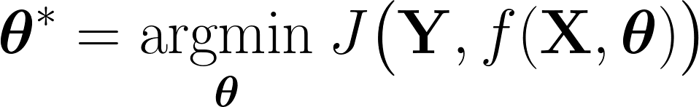
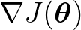
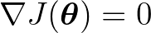

Optimization
How can we solve the optimization problem?
We can try to find an analytical solution to the problem:
We have to compute an expression for the gradient
2. We find a closed-form expression that tells us where are all the critical points:
3. We test all the critical points and we choose the one that minimizes the objective J.
Most of the time, we cannot find a closed-form analytical expression that solves this problem (root finding).
Closed-form expressions only exist for simple functions (e.g, linear).

Slide 25
Optimization
How can we solve the optimization problem?
Fortunately, we can try to find a numerical solution to this problem.
With this approach, we accept the idea of finding an approximate solution to the problem.
When using numerical methods, we start from a set of candidate solutions and we progressively improve them until we think the problem is solved well enough.

Slide 26
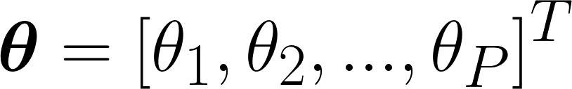
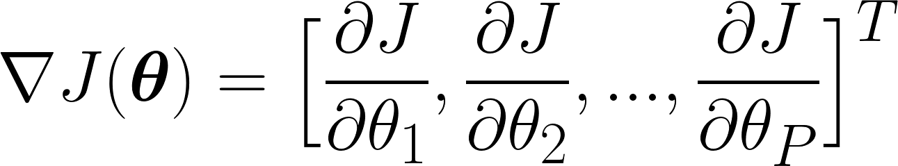
Gradient
The gradient can give us useful information:
Partial Derivatives
The gradient generalizes the notion of derivative.
It is a vector that points in the direction of the greatest increase of the objective.
It tells us what happens to the objective function when we apply a little change to each parameter.
How J changes when I apply a little perturbation to θ1 ?
How J changes when I apply a little perturbation to θP ?
How can we use this information during optimization?

Slide 27
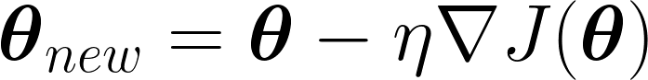
Gradient Descent
We can update the current parameters based on the gradient.
maximum
The gradient points in the direction of the greatest increase of the objective.
maximum
If we want to minimize J, we might want to do a little step in this direction:
minimum
minimum
New parameters
Current parameters
Learning Rate
Gradient

Slide 28
Gradient Descent
Algorithm
Choose the learning rate n
J(θ)
1
Randomly Initialize θ
2
3
Compute the Gradient
4
7
5
6
We start from a random solution, and we progressively improve it until convergence.
Update the Parameters
θ
No
Good Solution?
Yes
1
2
The algorithm is sensitive to the initialization point.
3
End
4
5

Slide 29
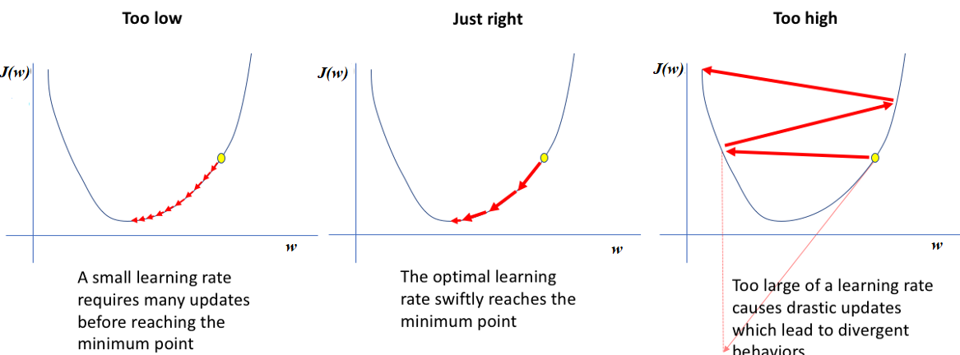
Learning Rate
Setting a proper learning rate Ɛ is crucial for gradient descent. A common choice is to set it as a constant value (e.g., n = 0.01).
J(θ)
J(θ)
J(θ)
θ
θ
θ

Slide 30
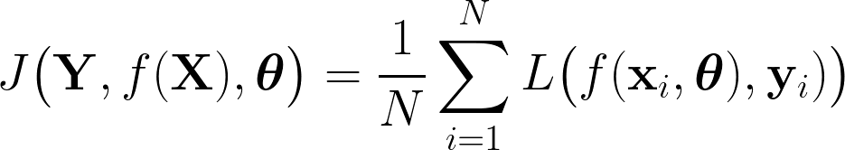
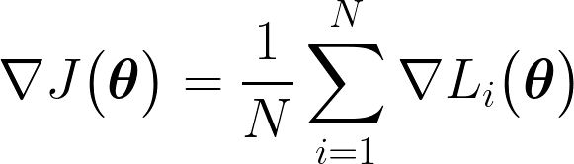
Stochastic Gradient Descent
To improve generalization, modern machine learning models are trained on large datasets.
In standard gradient descent, we update the parameters based on the gradient.
To compute the gradient, we need to process all the training examples:
The objective function is often decomposed as a sum over training samples (empirical risk minimization).
The total gradient is the average of the gradients computed for each training sample.
The complexity of gradient computation is O(N).

Slide 31
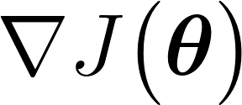

Stochastic Gradient Descent
What about approximating the gradient using little training data?
Features
Labels
x10, x11, x12, ………………………….x1D
x20, x21, x22, ………………………….x2D
x30, x31, x32, ………………………….x3D
x40, x41, x42, ………………………….x4D
x50, x51, x52, ………………………….x5D
x60, x61, x62, ………………………….x6D
x70, x71, x72, ………………………….x7D
x80, x81, x82, ………………………….x8D
x90, x91, x92, ………………………….x9D
y1
y2
y3
y4
y5
y6
y7
y8
y9
Number of Samples
Number of features

Slide 32
Stochastic Gradient Descent
What about approximating the gradient using little training data?
Features
Labels
x10, x11, x12, ………………………….x1D
x20, x21, x22, ………………………….x2D
x30, x31, x32, ………………………….x3D
x40, x41, x42, ………………………….x4D
x50, x51, x52, ………………………….x5D
x60, x61, x62, ………………………….x6D
x70, x71, x72, ………………………….x7D
x80, x81, x82, ………………………….x8D
x90, x91, x92, ………………………….x9D
y1
y2
y3
y4
y5
y6
y7
y8
y9
Number of Samples
Number of features

Slide 33
Stochastic Gradient Descent
What about approximating the gradient using little training data?
Features
Labels
x10, x11, x12, ………………………….x1D
x20, x21, x22, ………………………….x2D
x30, x31, x32, ………………………….x3D
x40, x41, x42, ………………………….x4D
x50, x51, x52, ………………………….x5D
x60, x61, x62, ………………………….x6D
x70, x71, x72, ………………………….x7D
x80, x81, x82, ………………………….x8D
x90, x91, x92, ………………………….x9D
y1
y2
y3
y4
y5
y6
y7
y8
y9
Number of Samples
Number of features

Slide 34
Stochastic Gradient Descent
What about approximating the gradient using little training data?
Features
Labels
x10, x11, x12, ………………………….x1D
x20, x21, x22, ………………………….x2D
x30, x31, x32, ………………………….x3D
x40, x41, x42, ………………………….x4D
x50, x51, x52, ………………………….x5D
x60, x61, x62, ………………………….x6D
x70, x71, x72, ………………………….x7D
x80, x81, x82, ………………………….x8D
x90, x91, x92, ………………………….x9D
y1
y2
y3
y4
y5
y6
y7
y8
y9
Minibatch: it is the set of training samples used for computing the gradient.
Number of Samples
Batch size: number of samples in the minibatch.
Epoch: it is a complete pass through all the training data
At the end of the first epoch, we used all of the data exactly once.
Number of features
We often train the machine learning model over multiple epochs.

Slide 35
Stochastic Gradient Descent
With SGD we use noisy versions of the gradient.
This introduces some randomness in the learning process that helps the algorithm to escape from saddle points and local minima.
Features
Labels
x10, x11, x12, ………………………….x1D
x20, x21, x22, ………………………….x2D
x30, x31, x32, ………………………….x3D
x40, x41, x42, ………………………….x4D
x50, x51, x52, ………………………….x5D
x60, x61, x62, ………………………….x6D
x70, x71, x72, ………………………….x7D
x80, x81, x82, ………………………….x8D
x90, x91, x92, ………………………….x9D
y1
y2
y3
y4
y5
y6
y7
y8
y9
Number of Samples
SGD naturally introduces some regularization that yields better generalization properties.
Number of features

Slide 36
Batch Size
The batch size manages the trade-off between the “accuracy” and the computational cost of the updates.
Batch size=N
If the batch size is equal to the number of training samples N, we have the standard gradient descent.
“Accurate” update, but slow
Batch size
The best value is normally in between the two extreme cases. We must carefully choose the batch size because it has a remarkable impact on the convergence speed and performance.
1< Batch size < N
Batch size=1
We update the weights after processing every single sample. This is called Online SGD
“Noisy” update, but fast

Slide 37

Variations
Several improvements have been proposed to the vanilla SGD algorithm:
Early Stopping
Learning Rate Annealing
SGD with Momentum
Adaptive Learning Rate methods (e.g, AdaGrad, RMSPROP, Adam)
Second Order Methods (e.g., Newton’s methods)
See the extra-lecture on “Gradient Descend Variants” for more details.

Slide 38


Advantages and Limitations
Limitations
O(θ)
Gradient descent can get stuck in local optima.
It depends on proper initialization.
It requires tuning the learning rate (and batch size for SGD).
θ
It is difficult to apply to non-differentiable loss functions.
From the “Deep Learning Book”
“In the past the application of gradient descent to nonconvex optimization problems was regarded as foolhardy or unprincipled. Today, we know that machine learning models work very well when trained with gradient descend.”
Advantages
Computationally efficient (computing the gradient is fast usually).
“The optimization algorithm may not be guaranteed to arrive at even a local minimum in a reasonable amount of time, but often finds a very low value of the cost function quickly enough to be useful”
It works well in practice (even with nonconvex objectives).
e.g., It proved capable of escaping from saddle points.

Slide 39
Basic Machine Learning
Capacity, Underfitting, Overfitting, Regularization

Slide 40

Capacity
Different machine learning algorithms can implement different sets of functions.
The capacity attempts to quantify how “big” (or “rich”) is the set of function that the model can implement.
It is usually not intended as the number of functions that can implement.
Instead, it more often refers to the variability in terms of “family” of functions (expressive power, richness).
For instance, a complex machine learning model that can implement linear, exponential, sinusoidal, and logarithmic functions has a larger capacity than one that implements linear functions only.

Slide 41
Generalization
Training a model requires solving an optimization problem.
We have to find the parameters of the function f that minimizes the objective function using the training data.
However, we are more interested in the performance achieved on data never seen before.
Generalization is the ability to perform well to new, previously unseen data.
A machine learning model generalizes well if the test loss is low enough (according to our application)
Training Loss: Objective function computed with the training set.
Test Loss: Objective function computed with the test set.

Slide 42



Underfitting
By analyzing training and test losses, we can identify some “pathologies” that often affect machine learning models.
One of these conditions is called underfitting.
It happens when the model is not able to achieve a training loss sufficiently low.
In both cases, the function found by the machine learning algorithm is too simple to explain well the training data.
Regression
Classification

Slide 43


Overfitting
Another possible pathology is overfitting.
It happens when the gap between the training and test losses is too large.
In both cases, the function is too complex to explain well the training data.
In an extreme case, the model just stores the training samples and thus behaves as a memory without generalization capabilities.
Regression
Classification

Slide 44


Underfitting, Overfitting, Capacity
Underfitting and Overfitting are connected to the capacity of the model.
Intuitively:
Too Low Capacity Underfitting
Proper Capacity Proper Fitting
Too High Capacity Overfitting
For each task, we have to choose a model with proper complexity.
Underfitting
(low capacity)
Proper Overfitting
(proper capacity)
Overfitting
(low capacity)

Slide 45
Underfitting, Overfitting, Dataset size
Underfitting and overfitting are influenced by the number of training samples as well.
Intuitively:
More Training Examples Better Generalization
Few Training Examples Overfitting
Small Number of Training Samples
High number of Training Samples
pdata
In this case, the training loss is low.
pdata
Also in this case the training loss is low.
We are anyway in an overfitting regime because the test loss is high.
However, this time we have a good generalization because
test loss is low.
prediction
prediction

Slide 46
Regularization
Better generalization is achievable by simply increasing the number of training examples.
Nonetheless, collecting additional data can be expensive or unfeasible.
Regularization techniques aim to counteract overfitting (and thus improve generalization).
Regularization is an active research area in machine learning.
Various techniques have been introduced, such as L1 regularization, L2 regularization, dropout, and many others.

Slide 47

Regularization
One regularization approach involves penalizing the selection of overly complex functions during training.
f1
f4
f2
Occam’s razor (1287-1346)
f3
f6
Among competing functions that explain well the training data, we should choose the “simplest” one.
f5
Which solution is preferable?
This solution is better because it explains well the training data while maintaining simplicity.

Slide 48
Linear Models

Slide 49





Linear Models
Linear Models are an example of simple machine learning models.
Linear Regression
w
x1
w1
w2
The output is a weighted sum of the input.
x2
w3
+
x3
The weights (and the bias) are learned during training.
w4
x4
w0
x
Bias
Inputs
Parameters
They can model linear input-output relationships only.
Training loss: MSE
‹#›

Slide 50




Linear Models
Linear models can be used for classification as well.
Logistic Regression (binary classification)
w
x1
w1
w2
The sigmoid is used to turn the output into a probability.
x2
w3
+
sigmoid
x3
Parameters
w4
x4
w0
The weights (and the bias) are learned during training.
Inputs
x
Bias
Sigmoid
It can be used only if the two classes are linearly separable.
Training loss: Binary Cross-Entropy
‹#›

Slide 51




Linear Models
Linear models can be used for classification as well.
Multiclass Logistic Regression (multiclass classification)
w
x1
P(y=1| x, w1)
The softmax is used to turn the output into a probability.
x2
S
O
F
T
M
A
X
P(y=2| x, w2)
x3
Inputs
P(y=1| x, w3)
The weights (and biases) are learned during training.
x4
x
Bias
It can be used only if the classes are linearly separable.
Training loss: Categorical Cross-Entropy
‹#›

Slide 52



Linear Models
Linear models are easy to optimize (convex optimization)
Fast training and predictions
Interpretability
Suitable for linearly separable classes (classification) or linear input-output mappings (regression).
For instance, logistic regression fails when applied on top of these inputs.
How can we extend linear models to support non-linear mappings?
‹#›

Slide 53


Linear Models
We can first apply a fixed non-linear transformation to our input features x.
This leads to the so-called linear basis function models.
The idea is to transform the input in a non-linear way such that it gets linearly separable.
Input Features
Then we apply a linear transformation on top of the transformed features.
Basis functions
(Kernel)
Parameters

Slide 54





Linear Models
The transformation can be used to make our classes linearly separable.
Linear Model
Input space
Transformed space
Transformed space
How can we design a non-linear transformation that makes our dataset linearly separable?

Slide 55



Linear Models
One way is to manually engineer
This is a challenging task that requires a lot of domain-specific human knowledge.
Why not learning from data?
This approach would be fully data-driven and does not need domain-specific human knowledge.
This is the idea behind neural networks!

Slide 56
Neural Networks

Slide 57



Neural Networks
Neural networks make the transformation learnable by parametrizing the basis functions :
We now have two types of parameters:
Parameters θ are used to learn the nonlinear transformation.
Parameters w are used to map the transformed features into the desired output.
Input Features
Parameters
Neural networks apply a linear transformation on top of features transformed in a non-linear way.
Neural networks aim to find the parameters θ that make our classes linearly separable. This learning modality is also called representation learning.
What is the price to pay for it?

Slide 58

Neural Networks
The price to pay for the increased complexity of the model is that the objective function is not convex anymore.
Parameter Space
For years, this issue was considered too difficult to overcome.
Input Features
Today, we know that the benefits of having a more complex model outweigh the harms coming from non-convex optimization.
Parameters
Convex
Non-Convex

Slide 59

Multilayer Perceptron (MLP)
There are multiple ways to construct parametric non-linear basis functions.
A popular neural network is called Multilayer Perceptron (MLP)
MLPs parametrize the transformation using the same form used for linear models:
We perform a linear transformation using a matrix of parameters W1.
2. We apply (element-wise) a non-linear activation
function f1.
Activation function
(elementwise)
Linear Transformation
(vector to vector)

Slide 60



Multilayer Perceptron (MLP)
(K x 1)
(K x M)
(M x P)
(P x 1)
Input
(P x 1)
(M x 1)
P = D +1
Parameter Matrix 1
(P x M)
Parameter Matrix 2
(M x K)

Slide 61

Multilayer Perceptron (MLP)
We first transform the input into an M-dimensional representation. This intermediate representation is called latent representation or hidden representation.
We then map our latent representation into the output space.
W2
W1
Neuron

Slide 62




Activation Functions
The activation must be non-linear. If we use a linear activation we end up with a linear model!
What about the non-linear activation function of the hidden layer?

Slide 63
Computational Graphs
A convenient way to represent the computations of neural networks is to use a computational graph.
x
dot
f⁽¹⁾
dot
f⁽²⁾
input
Output
W⁽¹⁾
W⁽²⁾
parameters
parameters
The computations of an MLP can be represented as a directed acyclic graph (DAG).

Slide 64

Universal Approximation
The universal approximation theorem states that an MLP with 1 hidden layer can approximate any continuous function arbitrarily well if enough neurons are employed (*).
More hidden neurons
Better approximation
(*) More precisely, the universal approximation theorem refers to Borel's measurable functions. Any continuous function on a closed and bounded set of RN is Borel measurable. This includes all the functions of practical interest.
(**) The theorem has been initially proved from sigmoid activations and later proved for a larger variety of functions (which include ReLU)

Slide 65

Universal Approximation
Regardless of what function we are trying to learn, we know that a large MLP will be able to represent that function.
However, there is no guarantee that the training algorithm will be learning that function.
Even if an MLP can represent a function, learning can fail because the training algorithm cannot find the parameters corresponding to the desired function.
The common belief that neural networks with a single hidden layer were enough to solve any problem has slowed down the exploration of deep models (i.e, models with many hidden layers).

Slide 66
Deep Neural Networks
Today we know that neural networks with many hidden layers (deep neural networks) significantly outperform neural networks with a single (large) hidden layer (shallow neural networks).
f1
f2
f3
f4
Neuron
(Hidden Units)
Deep neural networks (DNNs) are neural networks with multiple hidden layers.
yi
Deep neural networks employ a pipeline of non-linear transformations that “gradually” transform the input space into the output space.
Input
Output (predictions)
Layer1
Layer2
Layer3
Layer4
Latent (hidden) representation

Slide 67



Deep Neural Networks
Why this is helpful?
The world around us can be described efficiently through compositionality.
In particular, many signals (e.g, images and sounds) can be described well with a set of hierarchical representations where higher-level representations are derived by combining lower levels ones.
For a face recognition system :
Pixels => edges => Face parts => full faces
For a speech processing system:
Samples => sub-phonemes => phonemes=> words
Sub-phones
Phones
Words
Meaning
Samples
“Open the window”
“Open the window”

Slide 68
Deep Neural Networks
The “art” of learning hierarchical representations from data is called deep learning.
This is the dominant approach these days in machine learning.
Why this is helpful?
Deep neural networks offer a way to gradually learn these representations.
This learning modality gives an exponential representational advantage:
Sub-phones
Phones
Words
Meaning
Samples
We can compose low-level representations to learn higher-level abstractions.
We can reuse the learned representations multiple times.
“Open the window”
“Open the window”

Slide 69


Training
Despite the non-convex nature of the parameter space, we can effectively train neural networks with gradient descent.
To make this possible, we need:
To define an objective function
Mean Squared Error (Regression)
Binary Cross-Entropy (Binary Classification)
Categorical Cross-Entropy (MultiClass Classification)
2. Compute the gradient of the objective wrt the parameters.
How can we compute the gradient?

Slide 70

Chain Rule
When we have chains of computations like in neural networks, we can compute the gradients with the chain rule of calculus (not to be confused with the chain rule of probabilities).
Let’s assume we have a pipeline of computations (for simplicity w1 and w2 are scalars for now)
Loss (objective)
x
f⁽¹⁾
f⁽²⁾
L
We now apply a little perturbation to w1 :
input
This will cause a perturbation in the output of f⁽¹⁾
w1
w2
y
In turn, this causes a perturbation in the output of f⁽²⁾
Parameters
Label
The perturbation propagates throughout the chain until the final loss node is reached.

Slide 71


Chain Rule
Chain Rule:
x
f⁽¹⁾
f⁽²⁾
L
input
w1
w2
y
Redundant Computations
Label
Parameters

Slide 72




Chain Rule
We can apply the chain rule to arbitrarily long chains of computations:
x
f⁽¹⁾
f⁽²⁾
f⁽³⁾
f⁽⁴⁾
L
input
w1
w2
w3
w4
y
Parameters
Label
The number of redundant computations increases significantly with depth.

Slide 73
Backpropagation
Backpropagation is an algorithm that computes the chain rule efficiently.
x
f⁽¹⁾
f⁽²⁾
f⁽³⁾
f⁽⁴⁾
L
input
w1
w2
w3
w4
y
Parameters
Label
Backpropagation is a dynamic programming algorithm that saves and reuses some computations to compute the gradient efficiently.
In which order is convenient to do the computations?

Slide 74
Backpropagation
The most efficient way is to start from the last computation and progressively save partial results:
x
f⁽¹⁾
f⁽²⁾
f⁽³⁾
f⁽⁴⁾
L
input
w1
w2
w3
w4
y
Parameters
Label
Step 0
Run the forward step to obtain the activations of the network (points where to compute the derivatives).
grad_prod = 1, grad_par = {‘ ‘}

Slide 75

Backpropagation
The most efficient way is to start from the last computation and progressively save partial results:
x
f⁽¹⁾
f⁽²⁾
f⁽³⁾
f⁽⁴⁾
L
input
w1
w2
w3
w4
y
Parameters
Label
Stored
grad_prod = 1
Step 1
Compute derivative wrt the parameters (no parameters in this case)
Update grad_prod = grad_prod *

Slide 76


Backpropagation
The most efficient way is to start from the last computation and progressively save partial results:
x
f⁽¹⁾
f⁽²⁾
f⁽³⁾
f⁽⁴⁾
L
input
w1
w2
w3
w4
y
Parameters
Label
Stored
grad_prod =
Step 2
Compute derivative wrt the parameter w4:
grad_par{‘w4’} = grad_prod *
Update grad_prod = grad_prod *

Slide 77


Backpropagation
The most efficient way is to start from the last computation and progressively save partial results:
x
f⁽¹⁾
f⁽²⁾
f⁽³⁾
f⁽⁴⁾
L
input
w1
w2
w3
w4
y
Parameters
Label
Stored
grad_prod = *
Step 3
Compute derivative wrt the parameter w3:
grad_par{‘w3’} = grad_prod *
Update grad_prod = grad_prod *

Slide 78


Backpropagation
The most efficient way is to start from the last computation and progressively save partial results:
x
f⁽¹⁾
f⁽²⁾
f⁽³⁾
f⁽⁴⁾
L
input
w1
w2
w3
w4
y
Parameters
Label
Stored
grad_prod = * *
Step 4
Compute derivative wrt the parameter w2:
grad_par{‘w2’} = grad_prod *
Update grad_prod = grad_prod *

Slide 79

Backpropagation
The most efficient way is to start from the last computation and progressively save partial results:
x
f⁽¹⁾
f⁽²⁾
f⁽³⁾
f⁽⁴⁾
L
input
w1
w2
w3
w4
y
Parameters
Label
Stored
grad_prod = * * *
Step 5
Compute derivative wrt the parameter w1:
grad_par{‘w1’} = grad_prod *
The principle is the same when working with vectors instead of scalars. The products between numbers will become dot products between matrices.

Slide 80


Backpropagation
Popular deep learning toolkits such as PyTorch and Tensorflow automatically define the gradients for all the basic operations.
If we combine these basic operations to create more complex computations, we have the gradient for free!
This feature is called automatic differentiation.

Slide 81

Gradient Descent
After computing the gradient, we can train the model with gradient descent (or any variants of it):
We update all the parameters of all the layers with gradient descent.
The backpropagation algorithm is not an optimization algorithm. It is only a way to compute the gradient efficiently.
Gradient descent, instead, is an optimization algorithm as it attempts to optimize the objective function by progressively updating the parameters (weights) using the gradient.

Slide 82





Additional Material & Lab Session
3.1.0 Linear Basis Function Models
4.3.2 Logistic regression
5.0 - 5.4 Neural Networks
Chapter 5: Machine Learning Basics
Chapter 6: Deep Feedforward Networks
It might be object of questions in the exam.
Lecture on “Gradient Descent Variants” (50 minute-video, video, slides).
During the weekly lab session, we will do:
Tutorials on SpeechBrain
Audio Digit Classification with AudioMnist
Deadline: January, 30 11.59 pm

Slide 83


